Slide 1
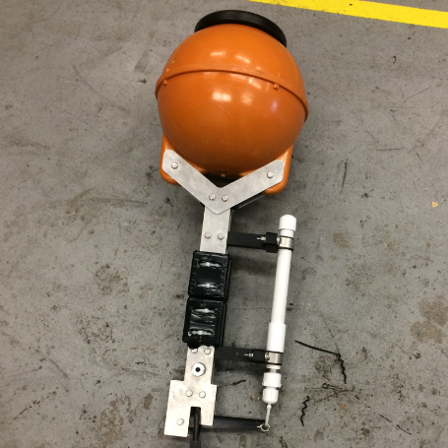
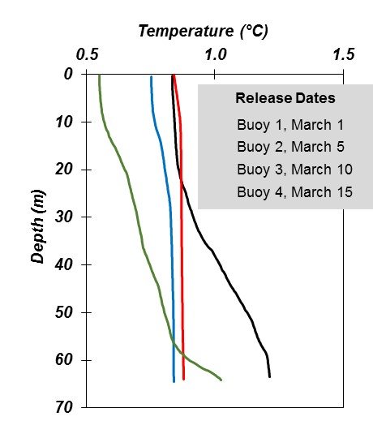
Pop-up Float
2018 Release Dates
2
1
4
3

Slide 2
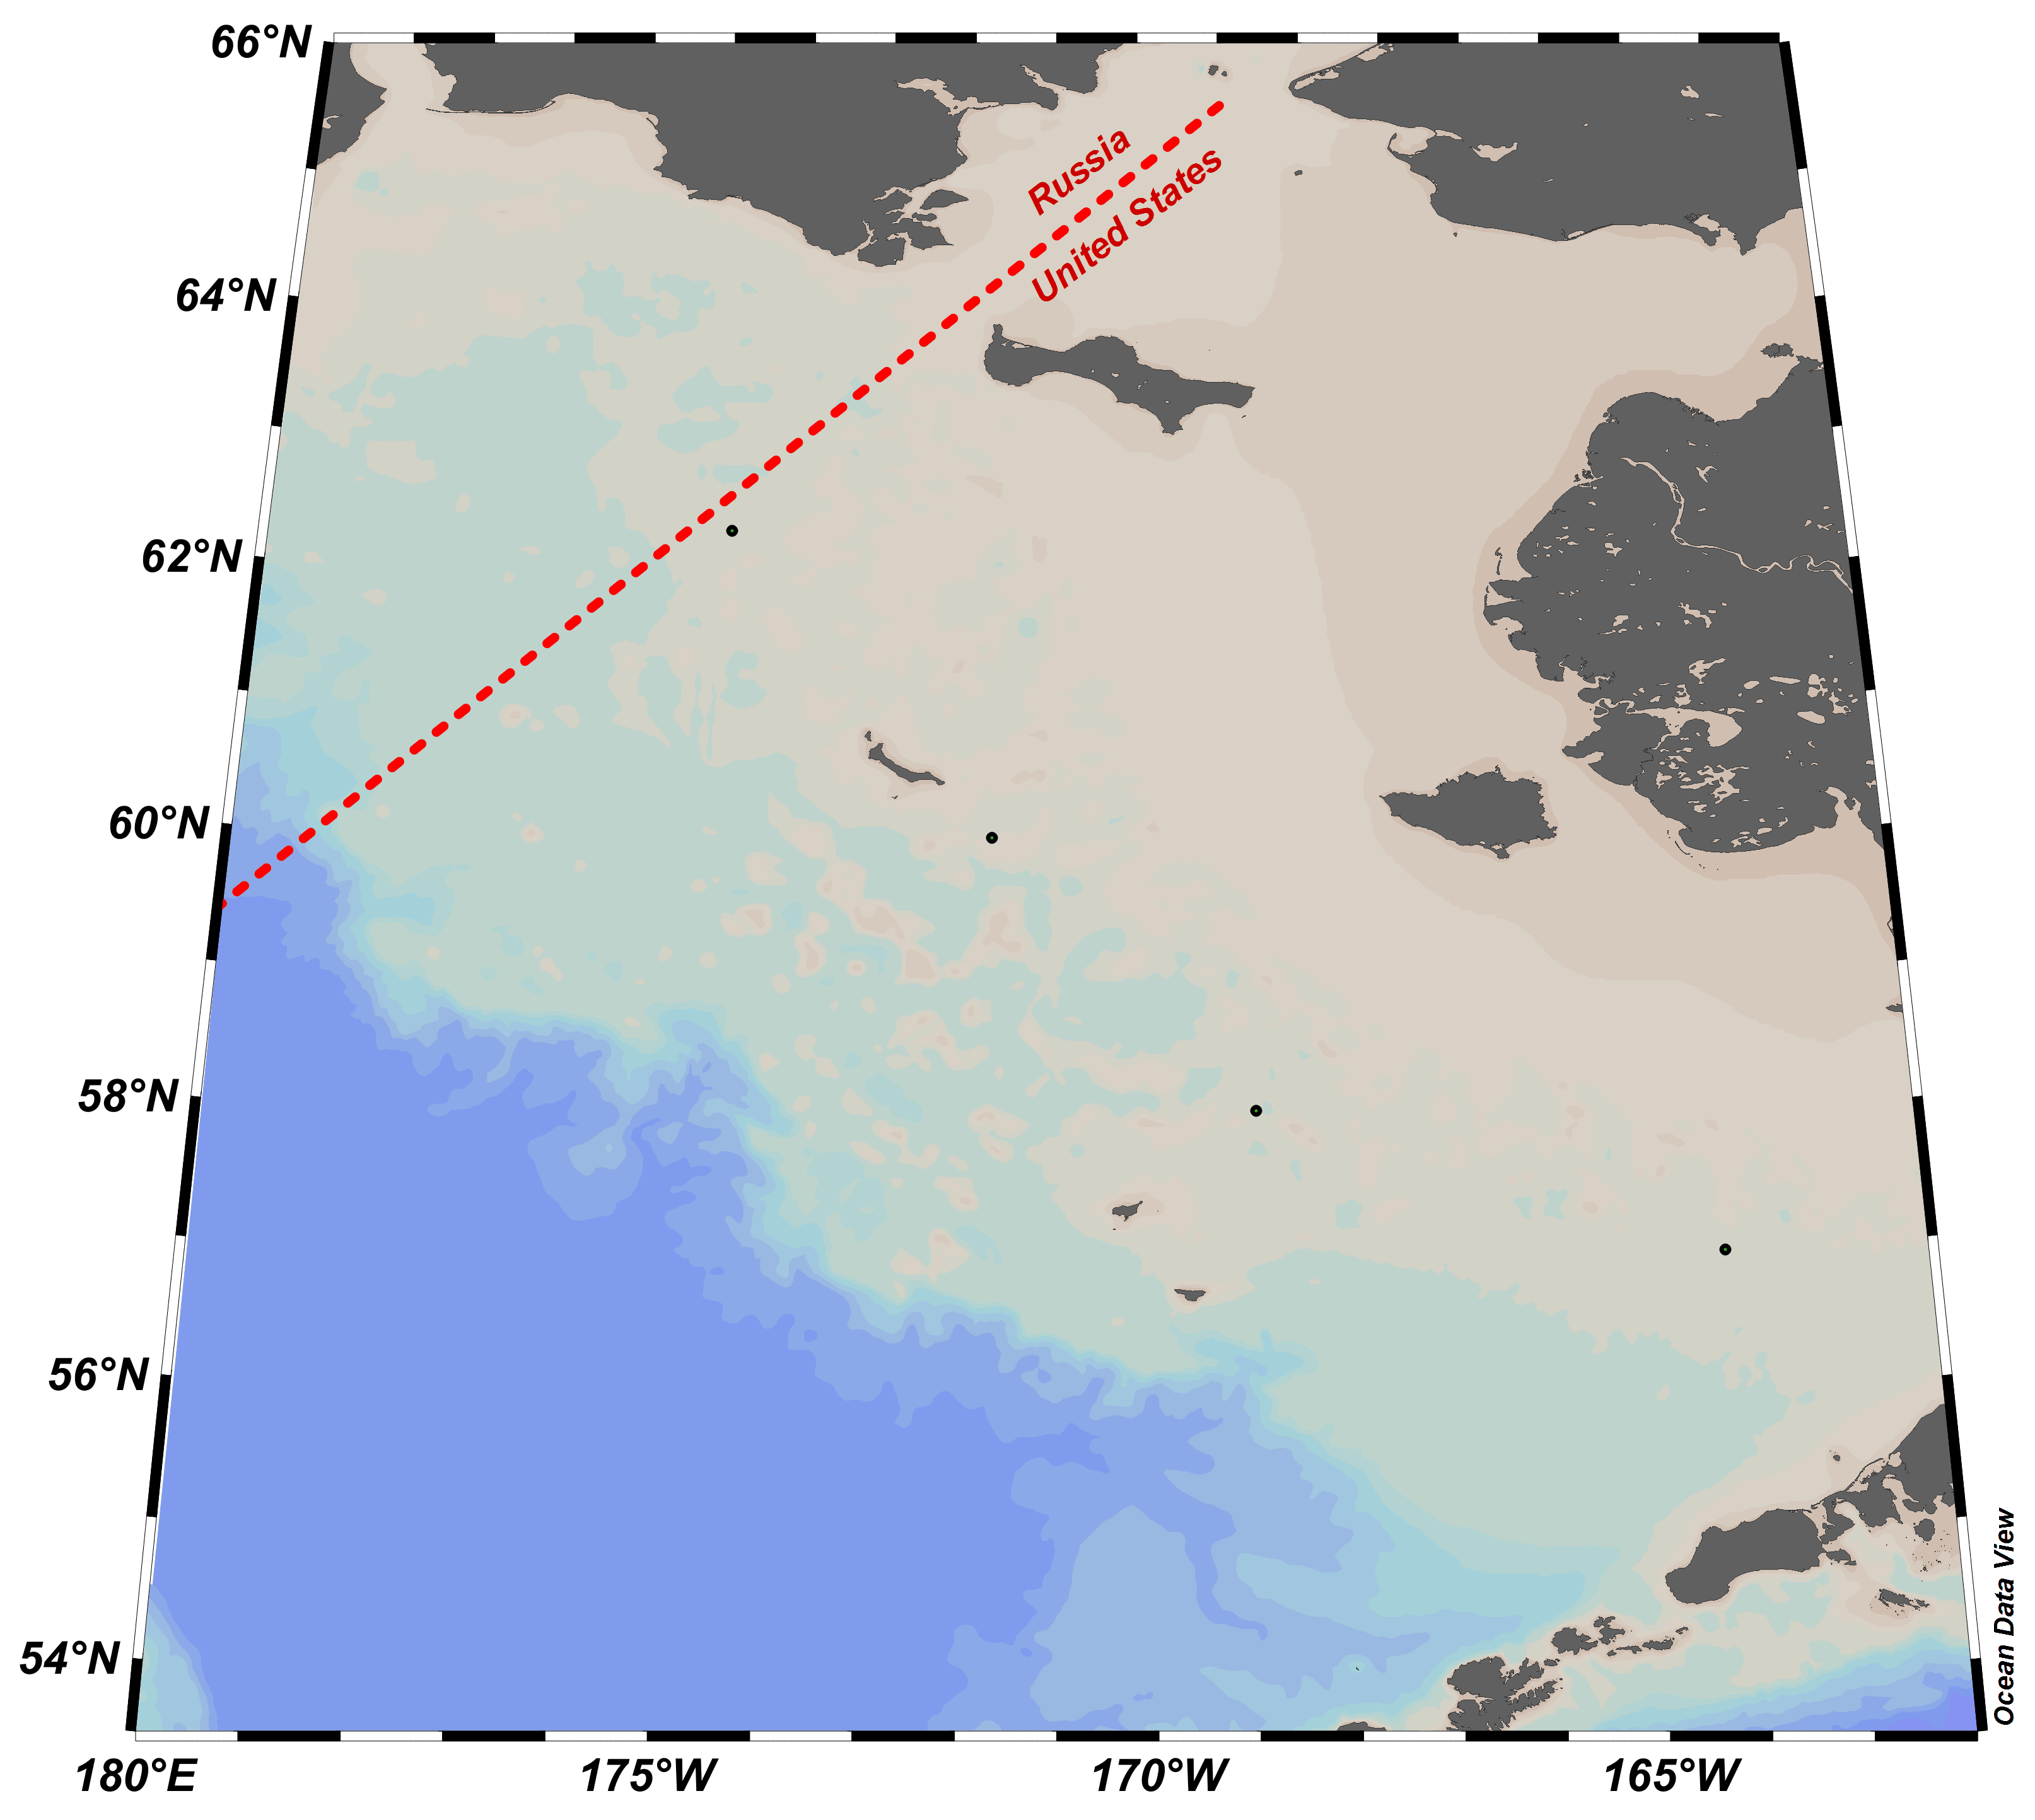
MAP OF THE 2019 – 2020 POP-UP BUOY OPERATIONAL FIELD TEST
KEY
Supporting Activities
AFSCSME
FOCI Mooring
Pop-up Buoy
Pop-up Cluster (6)
Includes ADCP
Includes PAR
Saildrone Track
Nome
St. Lawrence I.
SME-4
SME-3
M8
SME-2
SME-1
St. Matthew I.
M5
Nunivak I.
TIMELINE OF THE FIELD PROGRAM
Dutch Harbor
KEY
AFSC Funded Activities
PMEL Funded Activities
ITAE Funded Activities
NPRB Proposal
SME: Seafloor-Mounted upward-looking Echosounder
ADCP: Acoustic Doppler Current Profiler
PAR: Photosynthetically Active Radiation
Release of Pop-up buoy

